Slide 1
UW Climate Action Plan: Sustainability on Campus Questionnaire 2014
1

Slide 2
Why do a 2014 survey?
2
In February 2012, UW Keystone students sent a survey/questionnaire to gauge awareness of the Climate Action Plan (CAP):
Has CAP been effective?
Have interests changed?
How have new initiatives been embraced?
Hear feedback on what campus community members want and expect for UW sustainability.
The 2012 survey produced the Climate Action Plan Communications Plan, with recommendations on communicating sustainability to the campus
Notes:
All of which are reflective of Strategy 2.3 outlined in the UW Climate Action Plan for Outreach and Engagement through awareness and positive action

Slide 3
Survey Overview
3
Survey date: 2/10/2014 10:00 PM - 2/19/2014 12:01AM
Sent to: 93,000 email recipients
Responses: 1,631 (1.75%)
Response Breakdown:
Notes:
We were unable to send the survey through the same pathway as the previous surveyors and were not able to send multiple reminders as they did. As a result we went through the UW bulk mail process and had a higher sample size and fewer respondents.

Slide 4
How it compares to 2012:
4
2012 Survey Overview
Survey date: 2/14/2012 - 2/27/2014 12:01AM
Responses: 9,010 – 58,825 email recipients
Sent out 2 follow-up reminders
Similar distributions despite dissimilar respondents.
Notes:
Despite different pathways, campus representation is similar to the 2012 survey which had a 15% response rate with only a 1% margin of error at a 95% CI.
The follow-ups were sent out the second day and the start of the second week. Had not yet reached 1,000 responses by the time the first follow-up was sent out.

Slide 5
Interest in Reputation
5
Improved recognition and understanding of the importance of the Sierra Club’s “Cool School” Rankings and Princeton Review's Green Honor Roll
Sierra Club’s “Cool School” Ranking
Princeton Review’s Green Honor Roll
 | 2014 | 2012
I don't know what this is | 29.06% | 23.43%
Not important | 12.51% | 35.40%
Somewhat important | 34.95% | 15.73%
Very important | 23.48% | 25.44%
 | 2014 | 2012
I don't know what this is | 26.06% | 30.16%
Not important | 9.32% | 37.72%
Somewhat important | 34.58% | 9.79%
Very important | 30.04% | 22.29%
More than 58% of the 2014 respondents found the “Cool School” ranking somewhat to very important.
The percentage of respondents who found the Green Honor Roll award somewhat important to very important increased from 32% doubled to 64%.
Notes:
There appears to be an increased interest across all campus groups in the recognition of the UW as a leader in sustainability.

Slide 6
Interest in Reputation
6
Improved recognition and understanding of the importance of LEED rated buildings on campus.
LEED GOLD rating on all campus buildings completed since 2009.
 | 2014 | 2012
I don't know what this is | 16.68% | 40.25%
Not important | 6.38% | 31.48%
Somewhat important | 22.56% | 7.78%
Very important | 54.38% | 20.49%
The percentage of respondents who the LEED GOLD rating of campus buildings somewhat important to very important tripled from approximately 28% to 76%.

Slide 7
How have interests changed?
7
Which sustainability initiatives do you think the UW should be putting the most emphasis on in order to reduce carbon emissions?
Rank | 2014 | Rank | 2012
1 (High) | Decreasing waste sent landfills | 1 (High) | Decreasing amount of waste sent to landfills
2 | Decreasing solo drivers | 2 | Increasing purchasing of recycled products
3 | Encouraging use of U-PASS | 3 | Decreasing paper purchasing
4 | Decreasing paper purchasing | 4 | Maintaining campus energy consumption
5 | On-campus “Sustainability Summit” | 5 | Decreasing solo drivers
6 | Maintaining campus energy consumption | 6 | Increasing purchasing of locally food
7 | Creating campus office Green Teams | 7 | Increasing the number of LEED certified buildings on campus.
8 | Increasing purchasing of local food | 8 | Encouraging the use of U-PASS
9 | Increasing purchasing of recycled products | 9 | Decreasing water consumption.
10 | Increasing the number of LEED certified buildings on campus | 10 | Promoting the Campus Sustainability Fund
11 | Decreasing water consumption | 11 | Creating campus office Green Teams
12 (Low) | Promoting the Campus Sustainability Fund | 12 (Low) | On-campus “Sustainability Summit”
Notes:
Rankings reflect the percentage of respondents who thought theses initiatives should be given the most emphasis by UW.
Transportation has gained more interest, decreasing solo drivers and encouraging U-Pass.
Decreasing paper purchasing has remained high on the rankings.

Slide 8
How has awareness changed?
8
Q: The UW has many initiatives to reduce its carbon emissions. How aware are you of the following on-going initiatives at the UW:
Awareness remained high for:
Offering services for bicyclists such as racks and lockers (88%)
Awareness increased for:
Operating free shuttle services (69% to 90%)
Committing to a Climate Action Plan to reduce campus emissions (45% to 56%)
Awareness remained low for:
Developing a regional Smart Grid network (23%)
Purchasing only Energy Star rated appliances (39%)
Monitoring buildings' water consumption (43%)
Offering telecommuting options for staff (46%)
Funding for students and faculty working on sustainability focused projects and research* (48%)
Monitoring campus energy consumption (55%)
There appears to have been no decrease in awareness
Notes:
Percentages reflect percentage of respondents who were Somewhat to Very aware
Transportation has been one of the largest promotional interests of the communications as well as purely raising awareness about the Climate Action Plan.
* This question was not asked on the 2012 survey.

Slide 9
Campus Practices
9
Q: How often do you turn off the lights, turn off the computer, close windows, etc. upon leaving the room
Respondents were most likely to select “Almost Always” or “I do not have control over this” over “Never”
Responses remained mostly consistent between 2012 and 2014
New questions added to address new projects:
Sort waste according to compost, recycling or landfill
78.42% chose “Almost Always.” Undergraduate being the least likely to select this option.
Approximately 3% felt they did not have control over this
Choosing local food options over non-local
The largest percentage (35.99%) believe they didn’t have control over this
Notes:
Questions were asked to gauge how frequently respondents engage with sustainable practices in their day to day campus life
Include questions such as: How often do you Turn off the computer, Adjust the temperature, Make sure windows are closed, Turn off lights, Turn off my fan
Sort waste according to compost, recycling or landfill*
Opt to print double-sided*
Use a reusable water bottle or thermos*
Choose local food options over non –local*

Slide 10
How do we commute?
10
 | Undergraduates | Graduates and Professionals | Staff | Faculty | Total
Bus | 44.96% | 48.62% | 49.13% | 28.16% | 45.48%
Carpool with 2+ people | 2.52% | 1.98% | 9.63% | 6.80% | 6.70%
Drive yourself | 14.03% | 17.39% | 28.25% | 39.81% | 25.44%
Walk or Bike | 38.49% | 32.02% | 13.00% | 25.24% | 22.38%
Notes:
The majority of respondents selected that they bused to campus in second were those who selected driving themselves. Undergraduate were the most likely group to walk or bus to campus, but still had roughly 14% of respondents stating that they drive themselves to campus. Faculty made up the majority of those who drive themselves to campus followed by staff. However, staff made up the majority of those who bused to campus. Suggestions for improvement might be improved carpool coordination and encouragement among all groups. Sentiments were expressed in the comments section about wishing motorcycles had been included as another option and that the current metro scheduling and routes alongside impending bus cuts makes busing unreasonable

Slide 11
How do we commute?
11

Slide 12
UW Transportation
12
Use increased for:
UPASS (63% to 70%)
Carpool Permits (2% to 14%)
Use decreased for:
Full price parking (22% to 10%)
Use remained low for:
Zipcar (3%)
Husky Night Ride* (5%)
Vanpool* (1%)
Though carpool permits appear to have increased in use, this is an area where improvements could be made.
Notes:
Husky Night ride was not included on the previous survey. 17% of undergraduate students and 5% of graduate students have taken advantage of the night ride service.

Slide 13
We’ve grown to love UPASS
13
Please select the following statement(s) that apply to you:
I use public transportation more as a result of UPASS.
 | Undergraduate |  | Graduate/Professional |  | Staff |  | Faculty |  | Grand Total
 | 2014 | 2012 | 2014 | 2012 | 2014 | 2012 | 2014 | 2012 | 2014 | 2012
Yes | 78.31% | 46.09% | 72.28% | 34.27% | 52.80% | 21.64% | 41.75% | 13.23% | 60.15% | 29.90%
No | 21.69% | 53.91% | 27.72% | 65.73% | 47.20% | 78.36% | 58.25% | 83.77% | 39.85% | 70.10%
I drive less as a result of UPASS.
 | Undergraduate |  | Graduate/Professional |  | Staff |  | Faculty |  | Grand Total
 | 2014 | 2012 | 2014 | 2012 | 2014 | 2012 | 2014 | 2012 | 2014 | 2012
Yes | 38.03% | 17.68% | 46.82% | 17.88% | 35.99% | 13.41% | 28.64% | 11.79% | 37.28% | 15.15%
No | 61.97% | 82.32% | 53.18% | 82.12% | 64.01% | 86.59% | 71.36% | 88.21% | 62.72% | 84.85%
Notes:
Public transportation usage has more than doubled among participants because of the use of UPASS. According to our survey, largest increases were found among faculty and staff. In 2012, all groups had the majority of participants saying that UPASS did not increase their usage of public transportation
Decreased driving has more than doubled among participants because of the use of UPASS. These numbers are reflective of earlier findings discussing the increase in impact and emphasis placed on UPASS. Largest improvements came from the graduate/professional group. Though the number of those who say they do not drive less as a result of a UPASS has decreased by 20%, this response is still the majority across all groups
All groups experienced more than a 20% decrease of those who felt their use of public transportation has not changed.

Slide 14
More Concern and More Hope
14
How concerned are you about the consequences of climate change?
74% of respondents are “Very Concerned,” up from 61% in 2012
To what extent do you agree with the following statement: There are things I can do to help stop climate change.
90% of respondents “Somewhat” to “Strongly Agree,” up from 78% in 2012
Notes:
Despite an apparent increase in concern since 2012, there has also been an increase in the percentage of participants who believe they can help stop climate change. The passion and interest to make changes is present among the UW community given the sharing of appropriate knowledge and the right tools.

Slide 15
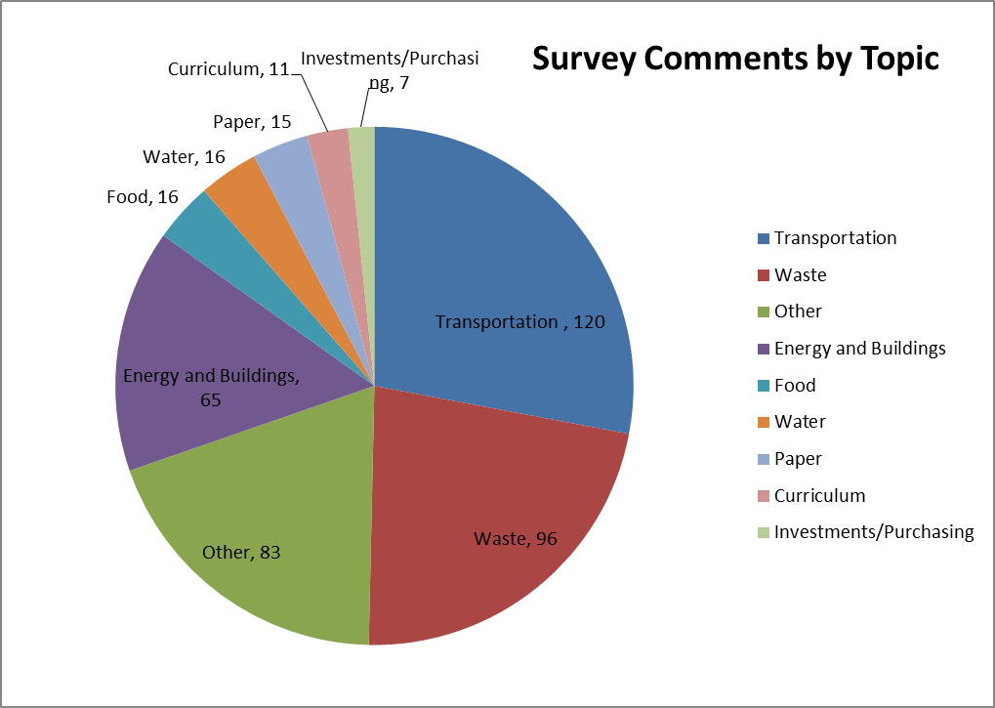
Voices from Around Campus
15
New to the 2014 survey, the opportunity to submit optional comments
Notes:
Felt it was important to add this question in order to hear what individuals want or feel passionately about in their campus lives and decisions.
Transportation drew the biggest responses, most voicing concern and frustration over the bus cuts, along with a broader option of choosing to participate in UPASS.
Waste comments focused on the availability and location of compost and waste bins on campus along with clearer signage at more locations on campus.

Slide 16
Select Comments from Around Campus
16
(CAP) is a bit of a snooze-o-rama. We need to generate excitement, energy and PASSION about climate change.
Don't cut a large proportion of metro bus routes that service UW!
Keep up the good work! I am so proud to be a student at one of the most environmentally-friendly universities.
I've noticed an increase in compost options on campus, but I think we need to increase them even more.
Notes:
In terms of communications and guiding personal decision making, what initiatives and tools do we want to emphasize and provide?
-Transportation (metro buses and carpooling), waste (clarity and efficiency), Smart Grid?, funding opportunities for students and researchers for sustainability products, reduced paper purchasing?
-The excel document with the raw data from the survey results, as well as a document with questions broke down by year, campus position and key findings in table form will be posted on line
-Comments are organized by themes and will be provided for affected departments

Slide 17
Moving Forward
17
Questions to ask ourselves
Next steps:
Share data with campus
Share comments, first with affected departments and then publicly
Questions/comments?
Thank you
Notes:
In terms of communications and guiding personal decision making, what initiatives and tools do we want to emphasize and provide?
-Transportation (metro buses and carpooling), waste (clarity and efficiency), Smart Grid?, funding opportunities for students and researchers for sustainability products, reduced paper purchasing?
-The excel document with the raw data from the survey results, as well as a document with questions broke down by year, campus position and key findings in table form will be posted on line
-Comments are organized by themes and will be provided for affected departments

